Slide 1
Audience, Market, Product
Planning your API documentation project
Bob Watson, Ph.D. Assistant Professor, Technical Communication
Mercer University School of Engineering
Copyright © 2016 Robert B. Watson, Ph.D.

Slide 2
Who is this talk for?
Technical writers starting on an API documentation project
Help you see the big picture
Help you organize the details
Technical writers who’ve written API documentation and will do it again
Help you look at the project from a new perspective
Spark some new ideas for your next project

Slide 3
What problems does this solve?
How do you sort all the “advice” and other helpful guidance you get from all the well-meaning people you work with?
How do you collect and organize information about your API in a way that helps you plan your documentation for the best customer experience?

Slide 4
What you’ll learn today
How to understand your API’s
Audience
Market
Product
How these factors influence your API documentation
How to create the best doc plan for your API

Slide 5
And by doc plan, I mean…
Whatever you use to plan your documentation
Agile (change-driven) Development
Your product roadmap
Your prioritized story backlog
Waterfall (plan-driven) development
Your documentation specification
Your documentation task list

Slide 6
What you won’t learn (today)
How to write API documentation
How to write API code samples
How to publish API documentation
Anything to do with authoring or content management systems
There are many resources to help you with those

Slide 7
About me
Assistant Prof. in Tech. Comm. at Mercer University
Ph.D. in Human Centered Design and Engineering from University of Washington
Research focus: API documentation
How people use it
How people write it
Professional experience
Software developer
Programmer-Writer

Slide 8
Where did all this come from?
Professional experience
15+ years writing API documentation
15+ years developing software and APIs
Academic research
First-hand research
Papers in ACM, IEEE
Lots of successes
Lots of mistakes

Slide 9
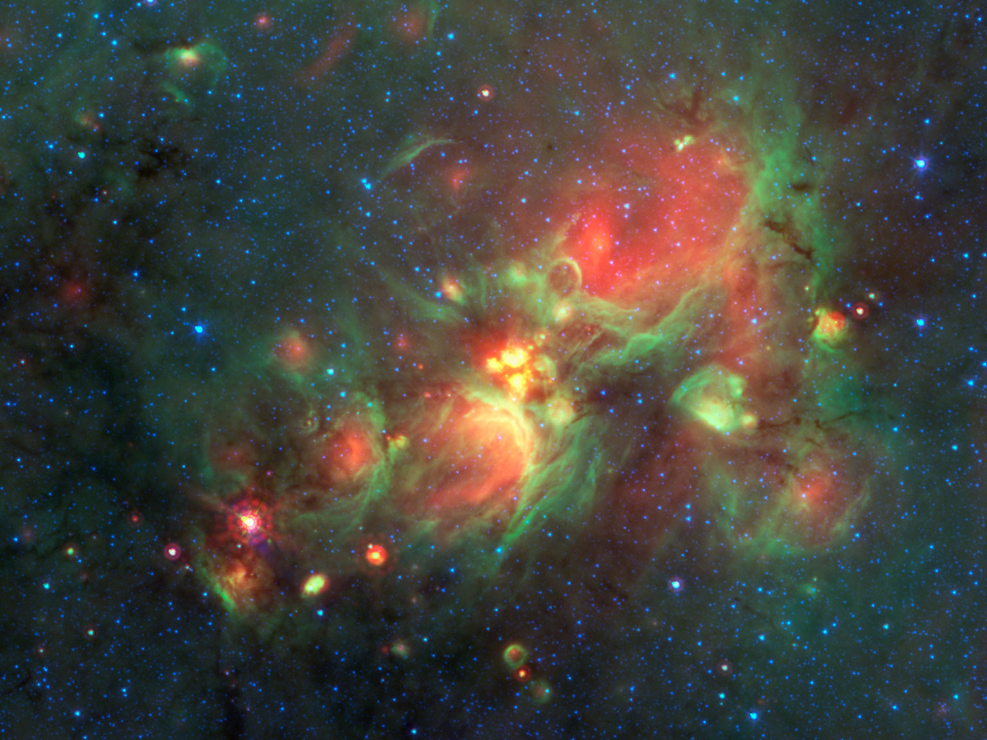
Exploring the API documentation universe

Slide 10
What is API documentation?
API documentation describes: How developers use an API while programming
API documentation includes some or all of:
Overview and value proposition
Hello World (first-use example)
Tutorials and examples (code samples)
Conceptual documentation
Reference documentation
Other, informal documentation

Slide 11
API documentation universe
Formal API documentation
StackOverflow
Personal blogs
Informal documentation
Other community-supported sites

Slide 12
Informal API documentation
What is it?
The content that you do not write
Such as:
StackOverflow
Personal blog posts
Community content
And more…
It is important to know your API’s informal docs
But, we won’t talk about it today

Slide 13
Formal API documentation
Overview
Hello world
Tutorial
Samples & Examples
Conceptual
Reference

Slide 14
Overview content
Appeals to technical and non-technical audiences
Presents overview and value proposition
Describes why you want to use the API
Includes
Opportunities the API offers
Problems the API solves
Sample use cases for the API
Overview
Hello world
Tutorial
Reference
Samples & Examples
Conceptual

Slide 15
Hello, World!
What’s a Hello World?
A common programming example that outputs “Hello world” when run
The first-use example
Hands-on example of API solving a simple, representative use case
Doesn’t have to actually output “Hello world”
Overview
Hello world
Tutorial
Reference
Samples & Examples
Conceptual

Slide 16
Samples and examples
Appeal to technical audience
Samples & Examples
Samples that demonstrate
Other use cases and applications of API
Implementation of specific functional blocks
Can include
Complete applications
Parts of applications
Variations of a base project
Customer-provided content
Overview
Hello world
Tutorial
Reference
Samples & Examples
Conceptual

Slide 17
Tutorial (How-To) content
Appeals to technical audience
Step-by-step topics that demonstrate how to implement common use cases
Provides task-based documentation
Supports and promotes adoption
Overview
Hello world
Tutorial
Reference
Samples & Examples
Conceptual

Slide 18
Conceptual documentation
Appeals to technical audience
Provide information about designer’s intent
The how and why behind the API.
Helps developers understand the API’s model and get “inside the head” of the API’s development team
Helps developers extend beyond tutorial examples
Overview
Hello world
Tutorial
Reference
Samples & Examples
Conceptual

Slide 19
Reference documentation
The API’s “dictionary definitions”
Can be integrated in the development environment
Includes descriptions of:
Elements
Methods
Parameters,
Objects
And much more!
Overview
Hello world
Tutorial
Reference
Samples & Examples
Conceptual

Slide 20
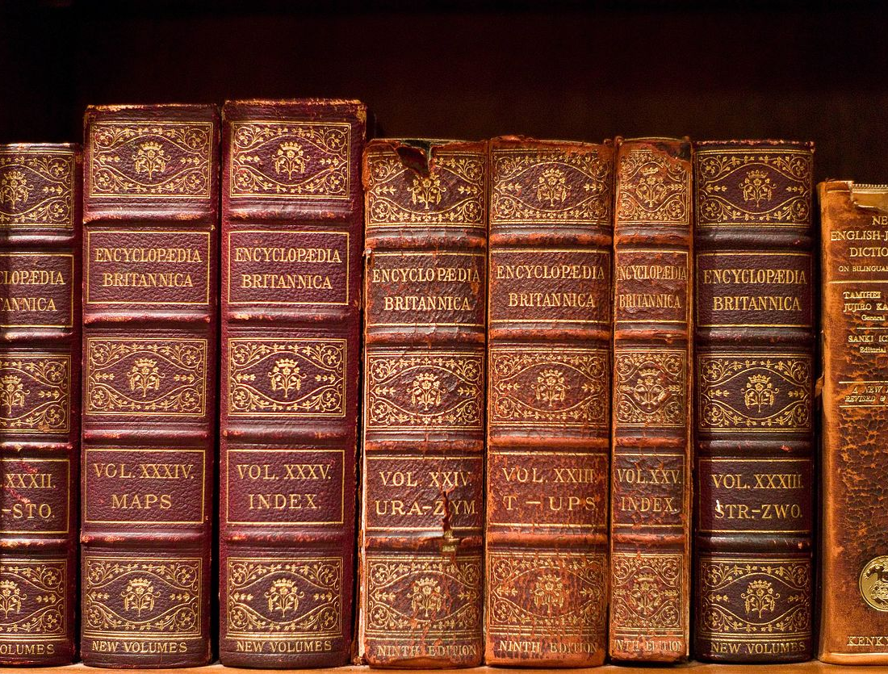
That’s a lot of documentation!

Slide 21
You can’t write it all
Fortunately, you don’t need to
API documentation use evolves over time
You can’t please all the people all the time
No matter how much you write, someone will want something you haven’t written
Have a plan
Know what’s important to your audience

Slide 22
What’s in the ideal doc set?
The ideal doc set provides
what customers need
when they need it
The ideal doc set evolves over time
Because the audience, market, and product evolve
The informal documentation also evolves

Slide 23
Let’s get organized
The perfect API doc plan starts here
Audience
Product
Market

Slide 24
Let’s get organized
You can’t do it all, at least not all at once.
The Audience, Market, Product framework helps identify the docs that are most important to your customers so that you can provide the documentation
That they need the most
When they need it the most

Slide 25
Audience
Who are you writing for?
Typically, software developers read API documentation
The Audience is influenced by the Market, so don’t jump to conclusions!
Don’t forget your API’s decision-makers
Might be the developers
Might be executives
Might be system or integration engineers

Slide 26
Audience – Questions
Who will use this API and the documentation?
What problems are they trying to solve?
How do they develop code?
How do they read the documentation?
Before coding?
When they are coding?

Slide 27
Audience – Problems
What type of problems are they trying to solve with your API?
Large, complex, system-sized problems
App-sized problems
Task-sized problems
This information provides a sense of readers’ perspective and scope

Slide 28
Audience – Developing Code
How do they develop code with your API?
Study (the docs) and Apply (the code)
Try (the code) first and Fix it (by reading the docs)
Copy and Paste (the code) and hope for the best
This info will help you prioritize the docs to write first
Determine what is most important to the customer

Slide 29
Audience – If all else fails
General guidelines (the one size that fits many)
What do they read before they start coding?
Overviews & value proposition
Hello World examples
Conceptual topics
What do they read when they are coding?
Community content
Reference topics
Tutorials and examples

Slide 30
Market
How is the API sold/acquired?
Who’s buying/using the API?
How competitive is the API in the market?
How mature is the API in the market?
How close to the company’s brand is the API?

Slide 31
Market – How is the API sold?
High-touch
Personal sales interactions
Coordinate documentation with sales & marketing
No-touch (Word-of-mouth)
The documentation IS the marketing (or a big part)
Overview content
Value proposition
Common use cases
Hello world
Lower the barrier to first success
Samples and references

Slide 32
Market – Who buys and who uses?
Buyer is the user
Documentation has a more technical tone
The API is judged by the documentation
Buyer is not the user
Buyer-oriented overview
Developer-oriented content
Keep them clear and distinct (and easy to differentiate)

Slide 33
Market – How competitive?
Crowded market
Differentiation is important
Competitive analysis
What will make your content help the customer more than the competition?
What will make your content impress the customer more?
Sparse market
Your API is unique to your company or problem
Differentiation is not so important

Slide 34
Market – How mature?
API is a newcomer
Need more market awareness
Need more marketing support
API is familiar
They know you and where to find you
Don’t disappoint
What is the state of the API’s community and informal documentation?

Slide 35
Market - How close to the brand?
The API IS the company
The API supports another product
The API is a skunkworks project
You have an API? What’s an API?

Slide 36
Market – If all else fails
If High-touch sales
Assume not-so-technical decision maker
API documentation must do limited “selling” (But you might need to help with sales collateral)
If Low/No-touch sales
Assume technical decision maker (the developer)
Assume documentation must help do the selling
Overview
Hello World

Slide 37
Product
Let’s talk about the actual API
How well does the API map to the problem it solves?
How well does the API design map to the way developers will use it?
How is the API used by the customer?

Slide 38
Product – API matches problem
Do the API terms and concepts map to the problem space’s concepts and vocabulary?
Terms and actions
Methods, elements, and fields
Close agreement
Simpler documentation
Arbitrary terms and concepts
More complex documentation

Slide 39
Product – API = Dev. style
Does the API support how developers will apply it?
Which development style is your API designed for?
Copy and Paste (the code) and hope for the best
Try (the code) first and Fix it (by reading the docs)
Study (the docs) and Apply (the code)

Slide 40
Copy-and-paste development
Just-in-time, trial-and-error development
Documentation can be in error responses
Minimal documentation outside of API
API docs should provide the info that the error messages cannot
Examples
Tutorials
Basic reference

Slide 41
Study-and-apply development
More background information is required
Tutorials
Conceptual
Examples
Detailed reference

Slide 42
How will customer use API?
Installation
System or account requirements
Security
Account or access keys
Configuration
Developer configuration
User configuration
Find out from subject-matter experts or try it yourself!

Slide 43
Take a breath
Time to catch up and put it all together

Slide 44
Putting it together
Get to know your API
Understand each component (or key components)
Understand the interactions and priorities
Understand the schedule(s)
Prepare your plan
Draft the textbook plan
Revise down to the ideal plan
Organize to make the actual plan

Slide 45
Draft the master plan
Identify the master documentation set
Required document types
Required detail of each type
Understand how your formal documentation will interact with the informal documentation
Adjust your master plan
Robust informal documentation = less formal
Little to no informal = more formal
Minimize redundancy

Slide 46
Revise down to the ideal plan
Apply the contextual elements to prioritize the docs in the master plan
Which topics are highest priority?
Which topics will need SME support?
Which topics require special environments, resources, or permissions?
Include a plan to update or modify earlier documents
As the API evolves, so should the documentation

Slide 47
Organize to create the real plan
Review your prioritized topics in the context of the API delivery schedule
Prioritize topics to meet the customer requirements
Have the necessary content ready when its needed
Include time for testing!
Regularly review and revise your plan

Slide 48
Review and questions
Keep listening to the audience, market, and product
Keep asking questions
Keep updating your plan
Oh, and that concludes the presentation!
Thank you
Questions?

Slide 49
References
About API documentation
http://blog.aquaplot.com/2016/11/08/writing-good-api-documentations/
http://www.madcapsoftware.com/blog/2016/10/06/5-questions-every-technical-writer-faces-api-documentation/
http://www.slideshare.net/sarahmaddox/api-types
Watson, R. B. (2012). Development and application of a heuristic to assess trends in API documentation. In Proceedings of the 30th ACM international conference on Design of communication (pp. 295–302). Seattle, WA: ACM.
Writing API documentation
http://sdkbridge.com/online-courses/
https://theamiableapi.com/2011/11/01/api-design-best-practice-write-helpful-documentation/
Images
https://www.nasa.gov/sites/default/files/thumbnails/image/pia18908-main.jpg
https://www.flickr.com/photos/joi/4059100968

Slide 50
References
How developers use API documentation
Brandt, J., Guo, P. J., Lewenstein, J., & Klemmer, S. R. (2008). Opportunistic programming: How rapid ideation and prototyping occur in practice (pp. 1–5). Presented at the Proceedings of the 4th international workshop on End-user software engineering, ACM.
Brandt, J., Guo, P. J., Lewenstein, J., Dontcheva, M., & Klemmer, S. R. (2009). Two Studies of Opportunistic Programming: Interleaving Web Foraging, Learning, and Writing Code. In Proceedings of the SIGCHI Conference on Human Factors in Computing Systems (pp. 1589–1598). New York, NY, USA: ACM. https://doi.org/10.1145/1518701.1518944
Watson, R. B. (2012). Development and application of a heuristic to assess trends in API documentation. In Proceedings of the 30th ACM international conference on Design of communication (pp. 295–302). Seattle, WA: ACM.
Robillard, M. P. (2009). What makes apis hard to learn? answers from developers. Software, IEEE, 26(6), 27–34.
Robillard, M. P., & Deline, R. (2011). A field study of API learning obstacles. Empirical Software Engineering, 16(6), 703–732. https://doi.org/DOI 10.1007/s10664-010-9150-8
Clarke, S. (2007, February 7). What is an End User Software Engineer? [InProceedings]. Retrieved October 26, 2014, from http://drops.dagstuhl.de/opus/volltexte/2007/1080/
Clarke, S. (2004, May 1). Measuring API Usability. Retrieved December 13, 2016, from http://www.drdobbs.com/windows/measuring-api-usability/184405654

